Slide 1

Cybersecurity and functional safety for devices and systems
IMS22CS508972
Support overview
Identity management and security (IMS)
<Mon. ##>, 2023

Slide 2
Device cybersecurity landscape and service portfolio

Slide 3
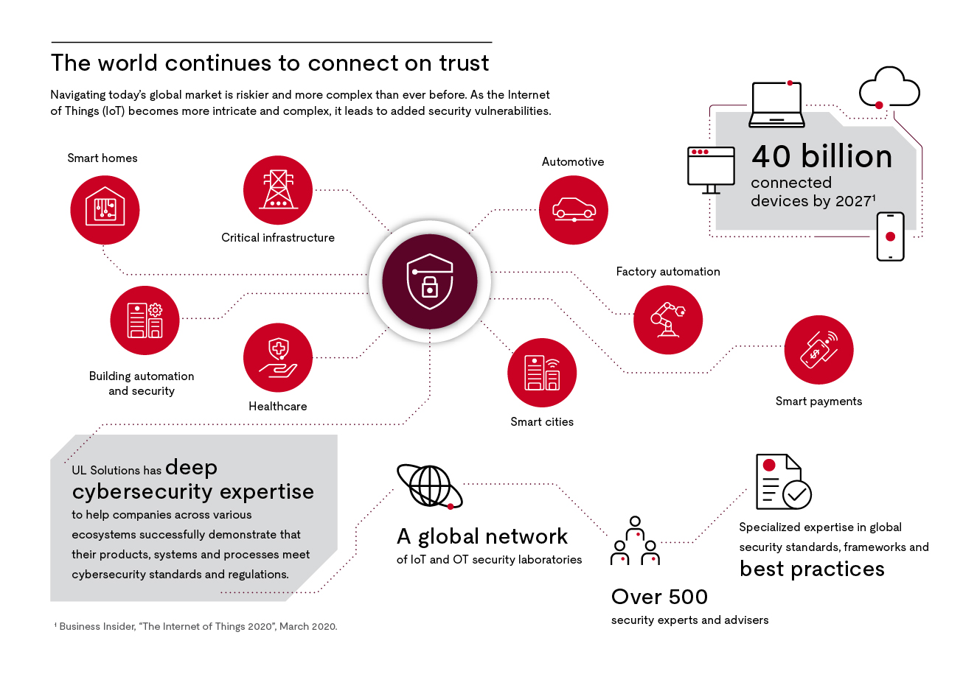

Slide 4












Life cycle strategy to compliance — what we offer
Testing and certification
Advisory
New product
Specification
Design
Implementation
Verification and validation
Operation
Maintenance
Decommissioning
TIC
Market enablement
Business and
technical
requirements
Processes,
procedures, governance
Safety and security audits
Training and workshops
Safety and security
evaluation
Safety risk assessment
OT risk assessment
CSMS for IACS
Penetration testing
Gap analysis
Approach/
architecture review
Road map
definition
A la carte
security testing
Approach
architect
Strategic support
Safety and security evaluations

Slide 5

Service portfolio
Digital health
Consumer IoT
Industrial IoT
  Cybersecurity and functional safety
Automotive
  Cybersecurity and functional safety
Autonomy safety

Slide 6
Service portfolio:
Digital health cybersecurity

Slide 7
What is digital health?
Digital health cybersecurity
Digital health encompasses:
Electronic health (e-health)
Mobile health (m-health)
Health information technology (IT)
Wearable devices
Artificial intelligence (AI)
Personalized medicine
Digital health technologies can be:
Medical products
In a medical product
Companion diagnostics
Adjunct to other medical products (devices, drugs, biologics)
Telehealth

Slide 8
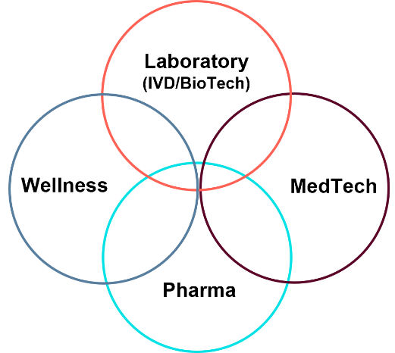
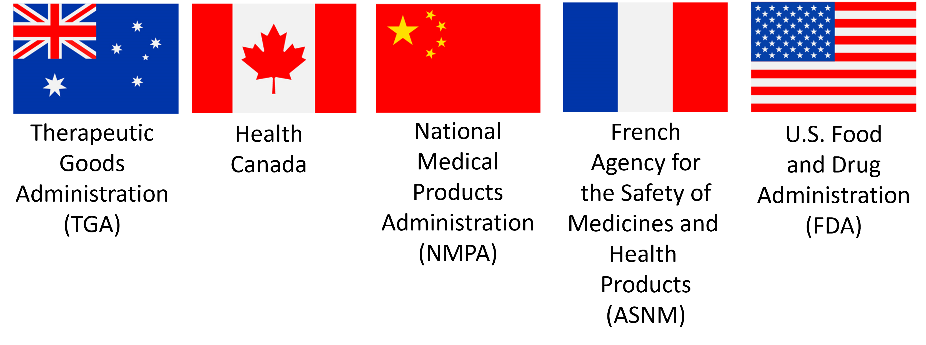

Who we serve
Digital health market segments
Medical device developers and manufacturers in local and global markets and healthcare domains
Notes:
Flag source: Cropped from UL SOLUTIONS COMMERCIAL RESOURCE CENTER

Slide 9
What we offer
Digital health cybersecurity and enablement
Training services
Customized, instructor-led training
Supporting and educating cybersecurity teams
Cybersecurity for healthcare products – UL 2900-1* and UL 2900-2-1**
Security risk management (TIR 57) and threat modeling
Medical device security features
Common vulnerability scoring system (CVSS v3.0)
Gap analysis
Assessment of product and/or process alignment with industry best practices or standards
Scoping of product and system and applicable security requirements
Evaluation for cybersecurity certification readiness
Testing services
Independent third-party test laboratories
Customized testing of product or infrastructure against industry best practices or standards
Certification services
Certification evaluation of a product, component, device or system based on standardized testable criteria and benchmark software vulnerabilities and weaknesses that can impact cybersecurity
*UL 2900-1, the Standard for Software Cybersecurity for Network-Connectable Products, Part 1: General Requirements
**UL 2900-2-1, the Standard for Software Cybersecurity for Network-Connectable Products, Part 2-1: Particular Requirements for Network Connectable Components of Healthcare and Wellness Systems
The UL 2900 series provides a global, unified approach to cybersecurity
that is useful across various business lines within an organization.

Slide 10
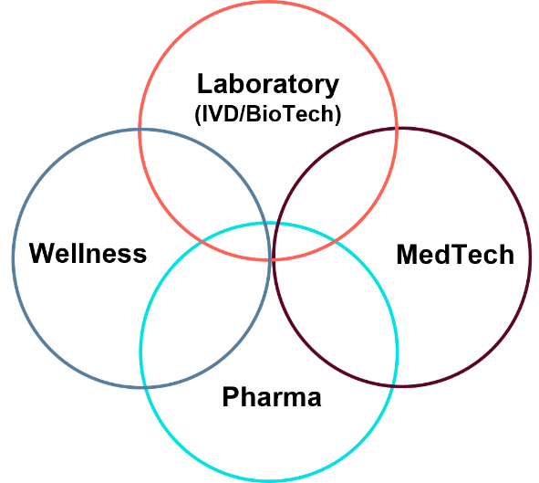
Value proposition
Digital health cybersecurity
Value proposition
Independent, trusted third-party testing and evaluation support
Extensive global expertise in healthcare ecosystem cybersecurity standards, frameworks and best practices
Comprehensive, end-to-end life cycle strategy encompassing conception to compliance
Full suite of resources designed to help manage cybersecurity risks
The UL 2900 series provides a set of transparent, testable cybersecurity criteria you can repeatedly use across different industry verticals
Validate cybersecurity capabilities to the marketplace
Demonstrate commitment to cybersecurity safety

Slide 11
Service portfolio:
Consumer IoT

Slide 12






IoT cybersecurity market landscape
Cybersecurity
Smart product
Connectivity
Ecosystem technology
OEM supply chain
5G, Wi-Fi, Zigbee, etc.
Product hardware components
Chips, embedded sensors, processors, controllers and a connectivity port/antenna that supplement traditional mechanical and electrical components
Embedded product software
An embedded operating system, onboard software applications, an enhanced user interface and product control components
Network communication layer
The protocols that enable the communication of the smart product, e.g., by routers (Wi-Fi) or direct (5G), making it a smart, connected product
Ancillary software
Software applications and platforms running on on-site and remote cloud servers and/or mobile applications that configure and manage the monitoring, control, optimization and autonomous operation of product functions, or that could enable the rapid creation of smart, connected business applications using data access, visualization and run-time tools
Analytics
The rules, business logic, big data analytical capabilities, artificial intelligence and machine learning that populate the algorithms involved in product operation and reveal new product insights
May be integral
Supply chain
Efficiency in supply chain management for product hardware, software and data is a key success factor.
Data management/privacy of data
Data management systems that enable aggregation, normalization and management protection of data (collection, storage, usage and destruction of data)
Governance, risk and compliance
Governance structures pertaining to security product life cycle management, vulnerability and risk management, policies and procedures and system security requirements

Slide 13

IoT differentials
Consumer and baseline IoT
vs.
Industrial IoT
UL MCV 1376, Methodology for Marketing Claim Verification: Security Capabilities Verified to Level Bronze/Silver/Gold/Platinum/Diamond
ETSI EN 303 645, Cyber Security for Consumer
Internet of Things:
Baseline Requirements
UL 2900-1, the Standard for Software Cybersecurity for Network-Connectable Products, Part 1: General Requirements
Wearables
Heavy machinery
Transportation
IEC 62443, Industrial Communication Networks – Network and System Security
UL 2900-1, the Standard for Software Cybersecurity for Network-Connectable Products, Part 1: General Requirements
ISO 21434, Road Vehicles – Cybersecurity Engineering
TVs, tablets, phones
Connected
devices
Smart cities
Smart devices
Automotive
Appliances
Automation
Home monitoring
Factories
Home automation
Medical

Slide 14










What are key IoT risks?
Insecure web interfaces
Insufficient authentication/authorization
Insecure network interfaces
Lack of transport encryption
Privacy concerns
Insecure cloud interfaces
Insecure mobile interfaces
Insufficient security/configurability
Insecure software/firmware
Poor physical security

Slide 15
Evolving regulations, guidelines and compliance for IoT
Oregon H.B. 2395
UK
Product Security and Telecommunications Infrastructure (PSTI) Bill
Government Response to the 2019 Consultation on Electric Vehicle Smart Charging
Code of Practice for Consumer IoT Security
California Cal Civ Code for Connected Devices
Finland
*Finland: National Consumer IoT Certification Scheme
DLC Cybersecurity Compliance
U.K.
EU
China National IoT Security Standards
EU:
GDPR
Cybersecurity Act (2019)
EU Radio Equipment Directive Article 3.3
ETSI EN 303 645
European Chips Act
Cyber Security Resilience Act(CRA)
Walmart® USA Product Safety and Compliance Standard
United States
China
Taiwan: Security Assessment Guidelines for IoT-enabled field applications
Baseline Cybersecurity Standard for Devices and Device Systems (ANSI/CTA-2088)
Taiwan
India
*India: TEC 31318-2021 Code of Practice for Securing Consumer IoT
Internet of Things Cybersecurity Improvement Act of 2020
Singapore
*Singapore:
National Cybersecurity Labeling Scheme
CITA Cybersecurity Certification
Test Plan for IoT Devices
Brazil
US, NIST:
Presidential Executive Order for Cybersecurity Labelling
Profile of the IoT Core Baseline for Consumer IoT Products (NIST 8425)
IoT Device Cybersecurity Guidance for the Federal Government (800-213A)
IoT Device Cybersecurity Capability Core Baseline (NISTIR 8259A)
IoT Non-Technical Supporting Capability Core Baseline (NISTIR 8259B)
Multidisciplinary Approach in the Engineering of Trustworthy Secure Systems (800-160)
Chips and Science Act
Brazil: Act 77 Cybersecurity Requirements for Telecommunications equipment in reference to: Act 7280
Australia
Australia: AS4755.2
Securing the IoT for Consumers
Landscape call-outs
U.S.: NIST 8425 and Chips and Science Act
EU: RED Article 3.3(d)(e)(f) and Cybersecurity Resilience Act (CRA) and European Chips Act
Global: IEC 62443 (IACS), ISO2700x,, PCI DSS

Slide 16

Who we serve
depend on connectivity and data sharing to deliver Industry 4.0 benefits such as increased operating productivity and enhanced safety, as well as reduced downtime and costs.
Consumer IoT market segments
Original equipment manufacturers (OEMs) of consumer IoT products:
Smart home products
Home automation products
Smart appliances
Wearables
Wellness devices

Slide 17
What we offer
Consumer IoT security and enablement
Certification
  ETSI EN 303 645
  UL 2900
  UL Verified IoT Device Security Rating program
Custom testing services
Gap analysis
Advisory and training
  IoT masterclass and webinar
  IoT jumpstart program

Slide 18
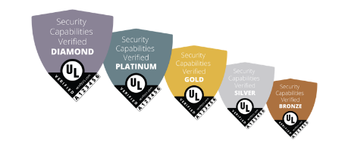
Value proposition
Consumer IoT cybersecurity
End-to-end life cycle service strategy
Thorough understanding of regulations and requirements across all target markets
Help you meet legal and regulatory demands regarding cybersecurity requirements
Help you enter target markets smoothly and efficiently
The IoT Security Rating offers manufacturers the following benefits:
Make product security more transparent and accessible to consumers
Use security as a competitive differentiator through the associated security label
Leverage the IoT Security Rating to perform adequate product security due diligence
Help achieve compliance with (upcoming) regulations

Slide 19
Service portfolio:
Industrial IoT — cybersecurity and functional safety

Slide 20



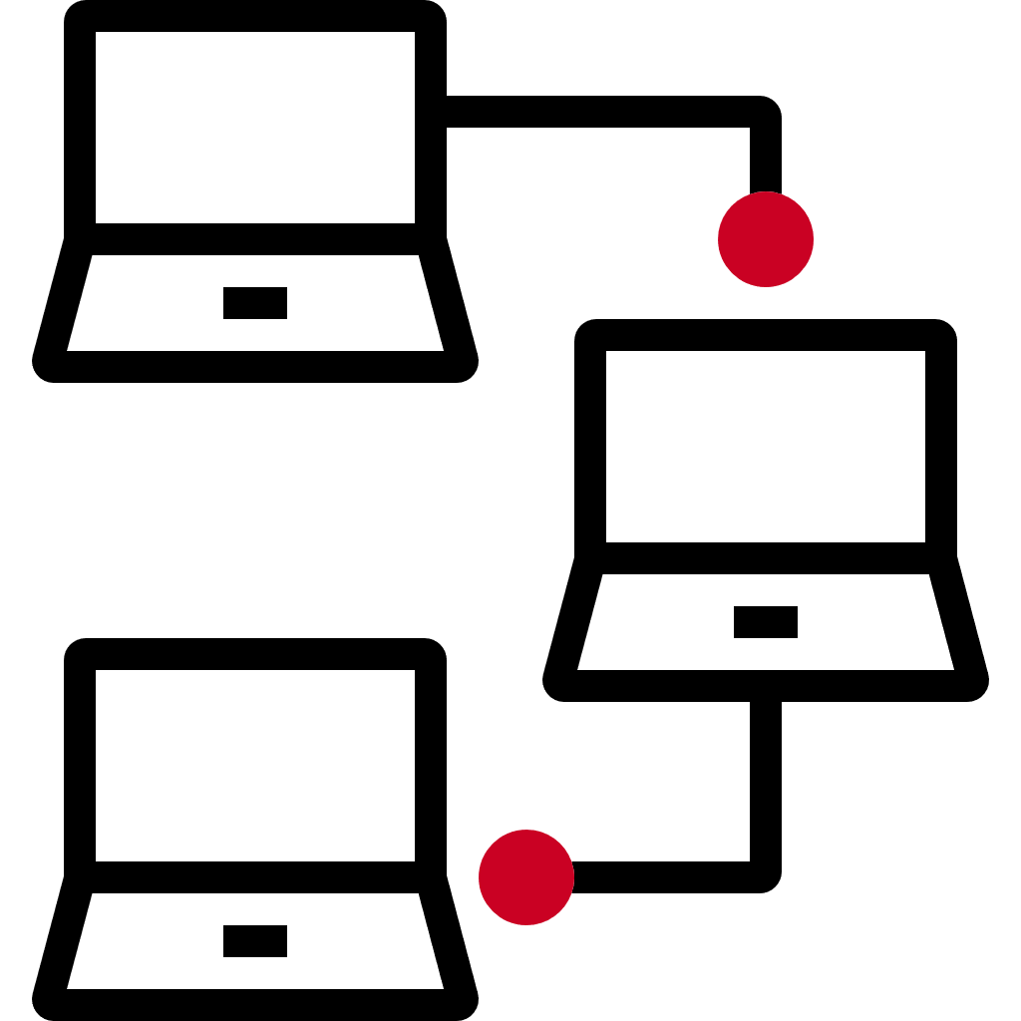

Industry 4.0 trends
Industrial ecosystems are evolving, and safety and security are crucial components of this evolution.
Digital technologies
have penetrated manufacturing and continue to do so at an ever-increasing rate.
Merging of the cyber and physical worlds means improved efficiency but also results in an increased exposure to cybersecurity and safety risks.
Smart factories depend on connectivity to deliver Industry 4.0 benefits, such as increased operating productivity and reduced downtime and costs.

Slide 21







Industry 4.0 customer challenges
depend on connectivity and data sharing to deliver Industry 4.0 benefits such as increased operating productivity and enhanced safety, as well as reduced downtime and costs.
Understanding the right level of safety and security for a product or service and how certain requirements or industry best practices may be applied
Recognizing and minimizing risks associated with the industrial Internet of Things (IIoT) and operational technology (OT) infrastructure
Identifying how to embed safety and security into the development process while demonstrating resilient cybersecurity with OT operations and business continuity
Confirming supply chain cybersecurity
Demonstrating that products and systems meet regulatory requirements for functional safety and cybersecurity

Slide 22

Industry 4.0 market segments — who we serve
The industrial landscape is complex, and UL Solutions can support stakeholders in machinery, robotics, energy generation, mining, hazardous environments and other areas that require safety-critical systems.
Service providers
System integration (SI)
ISA/IEC 62443-2 for cybersecurity
IEC 61511, ISO 13849 and systems functional safety
Maintenance
Safety and security capabilities and processes
System security and resilience
Training, assessment and organization management (FSM)
Operators (plant owners)
ISA/IEC 62443-1 and ISA/IEC 62443-2 for cybersecurity
IEC 61511, ISO 13849 and process industry functional safety
Component and product manufacturers
ISA/IEC 62443-4 for cybersecurity
IEC 61508, ISO 13849 and device functional safety
Device/product certification training and assessment services

Slide 23
What we offer
Industry 4.0 cybersecurity and enablement
ISA/IEC 62443 addresses risk found in industrial communication networks by defining procedures for implementing electronically secure plants, facilities and systems across industries (horizontal standard).
Regulatory landscaping and market enablement
IEC 62443 education and training
Advisory, risk assessments and documentation review
IEC 62443 gap analysis
IEC 62443 audit and certification
Auditing and surveillance
Penetration testing of products, systems and infrastructures

Slide 24
What we offer
Industrial functional safety
What we offer
Regulatory landscaping and market enablement
IEC 61508 education and training
IEC 61511 education and training
Machinery functional safety education and training
Agriculture and construction functional safety education and training
Advisory, risk assessments and documentation review
Functional safety gap analysis
Functional safety audit and certification
Auditing and surveillance
Asset, module and management assessment
Functional safety product assessment​
Functional safety asset assessment​
Functional safety management
Regulatory compliance​
Machinery directive type approvals​
ATEX directive type approvals​

Slide 25
Value proposition
Industrial cybersecurity and functional safety
For component and product manufacturers, compliance with ISA/IEC 62443, IEC 61508 and ISO 13849 can help demonstrate your systems and components’ safety and security and enhance your market position.
For industrial control system (ICS) integrators and users of control systems, compliance with ISA/IEC 62443, IEC 61511 and ISO 13849 is a powerful way to achieve increased brand protection and expanded competitive advantage.
Our global team spans more than 15 countries, allowing us to simplify the assessment and certification process and provide local services where you need them and in your local language.
As a global leader in providing assessments, audits and trainings across various industries and standards, our integrated Functional Safety and Cybersecurity team can provide holistic support for multiple standards, regulations and other technical requirements.

Slide 26
Service portfolio:
Automotive — cybersecurity and functional safety

Slide 27
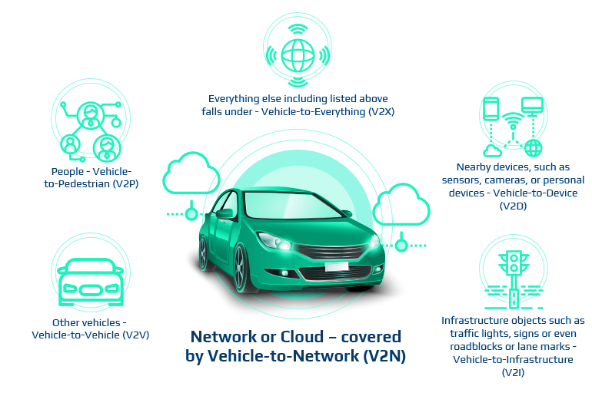
What can vehicles connect to?
Cloud services and everything else — vehicle-to-everything (V2X)
People — vehicle-to-pedestrian (V2P)
Nearby devices, such as sensors, cameras or personal devices — vehicle-to-device (V2D)
Other vehicles — vehicle-to-vehicle (V2V)
Network or cloud — covered by vehicle-to-network
Infrastructure objects, such as traffic lights, signs and roadblocks or lane marks — vehicle-to-infrastructure (V2I)

Slide 28
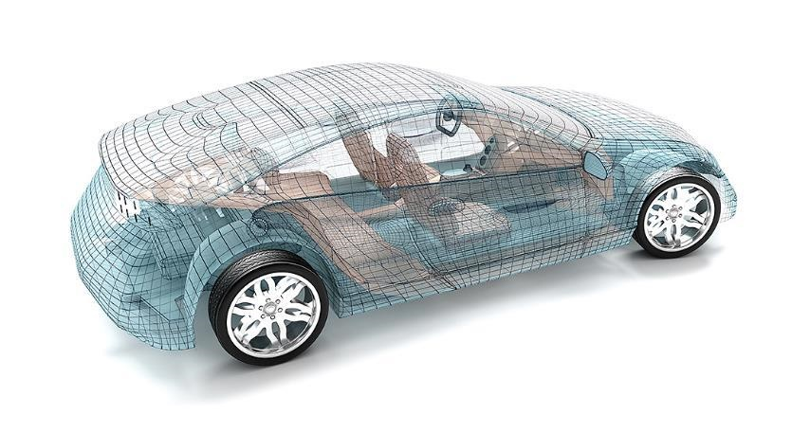
Security and safety focus
IMS22CS508972
Safety integrity
Safety regulations and requirements
Correct automotive safety integrity level (ASIL)
Functional safety in product and system development processes
Safety level of products and components
Vehicle networks
Remote/physical attack surfaces
Network protocols (CAN, FlexRay, MOST)
Interfaces (OBD II, USB media)
Components (ECUs, sensors)
In-vehicle security
Security risk assessment
Threat modeling
Architecture/design review
Vulnerability scanning
Security testing
Active and passive security measures (IDS, monitoring, access control, encryption, segmentation, etc.)
Telematics/infotainment
Communication interfaces (Wi-Fi, BLE, USB)
HMI interfaces (voice, GUI, BT)
Network/app protocols
Digital key

Slide 29



Software in connected vehicles
As manufacturers introduce more and more safety and connectivity features into their vehicles, this number is expected to grow dramatically.
Source: McKinsey, “The race for cybersecurity: Protecting the connected car in the era of new regulation,” October 2019

Slide 30


Who we service
Automotive market segments
Tier 1 suppliers
Tier 2 suppliers
Semiconductor manufacturers
OEMs
Energy systems suppliers
Charging infrastructure companies
The automotive market continues to evolve, and UL Solutions can provide services for vehicle level, systems, software and hardware to support connected and electrical vehicle innovation for safety and security.

Slide 31
What we offer
Automotive security and enablement
Training
Automotive cybersecurity landscape
Principles of risk management
Threat modeling and analysis
Advisory
Gap analysis
Cybersecurity management systems (CSMS) framework
Software update management systems (SUMS) framework
Risk management framework
Threat analysis and risk assessment framework
Cybersecurity incidence monitoring and evaluation
Supply chain management
Vehicle, systems and management assessment
Cybersecurity assessment​
System testing​
Penetration testing​
​
Regulatory compliance​
UNECE R155 and R156 type approvals​
CSMS audit and assessment​
SUMS audit and assessment

Slide 32
Value proposition
Automotive cybersecurity
Major benefits for automotive OEMs and suppliers:
Embedding security into R&D processes
Thorough understanding of regulations and requirements in your target markets
Determine the right level of security for products/systems
Instill cybersecurity rigor into your processes
Incorporate security into the design of systems and products
Meeting regulatory requirements and helping mitigate risks
Take care of product security due diligence
Meet legal and regulatory demands regarding cybersecurity requirements
Enter target markets smoothly and efficiently
Managing supply chain complexity and risk​
Discover, manage and mitigate supply chain risks​
Build trust with security across your supply network
Differentiate products/systems based on security​
Demonstrate security compliance to a wide range of target markets and customers​
Demonstrate validation of security to customers​
Enhance your brand by showcasing security transparency and commitment

Slide 33
What we offer
Automotive functional safety
What we offer
Training
Automotive functional safety (ISO 26262)
Autonomy safety training (ISO 21448 and UL 4600, the Standard for Evaluation of Autonomous Products)
Machine learning training and other related subjects
See our partner site with Method Park by UL Solutions for a full training list
Advisory
Gap analysis
Functional safety management systems (FSM) framework
Risk management framework (HARA, FTA, STPA and STAMP)
FMEDA calculation and training
Confirmation reviews
Vehicle, module and management assessment
Functional safety product assessment​
Functional safety management
Autonomy safety (SOTIF — ISO 21448 and UL 4600)
​
Regulatory compliance​
EU homologation requirements call for functional safety for on-road approval (minimum steering and braking)
Functional safety certification

Slide 34
Value proposition
Automotive functional safety
Major benefits for automotive OEMs and suppliers:
Embedding functional safety into R&D processes
Thorough understanding of regulations and requirements in your target markets
Determine the right ASIL with functional safety rigor built into your processes
Incorporate functional safety into system and product design
Meeting regulatory requirements and helping to mitigate risks
Product compliance support to meet regulatory and market demands through the entire supply chain
Meet legal and regulatory demands regarding functional safety requirements
Enter target markets smoothly and efficiently
Managing supply chain complexity and risk​
Discover, manage and mitigate supply chain risks​
Build trust with functional safety across your supply network​
Differentiate products/systems based on safety and security​
Demonstrate compliance with a wide range of target markets and customers​
Demonstrate ASIL validation to customers​
Enhance your brand by showcasing safety transparency and commitment

Slide 35
Service portfolio:
Autonomy safety

Slide 36

Who we serve
depend on connectivity and data sharing to deliver Industry 4.0 benefits such as increased operating productivity and enhanced safety, as well as reduced downtime and costs.
Autonomy market segments
Autonomy stack providers
Tier 1 suppliers
Tier 2 suppliers
OEMs
Software development companies
Rideshare companies
Whether you are a startup, an OEM or a member of the supply chain, UL Solutions can provide services across the autonomous system development life cycle.

Slide 37
Four major standards in autonomous vehicle (AV) safety
ISO 21448
UL 4600
ISO 26262
ISO/SAE 21434
ISO 21448
Addresses ADAS for products at L2/L3 and can be extended for L4/L5 architectures
Provides a framework for verification and validation of highly automated systems
Widescale automotive industry buy-in
UL 4600
Ed. 3 released in 2023
Scope is only for full autonomy (L4/L5)
Guidance for many hazardous behaviors, including field operation, AI/ML, data pipeline, etc.
Often requires arguments that can be made using ISO 26262, ISO 21448 and ISO/SAE 21434 frameworks
ISO/SAE 21434
Process based cybersecurity
Well matched to the terminology of ISO 26262
Widescale automotive industry buy-in
ISO 26262
Well established/widely used
Restricted in scope to traditional malfunction
A basis for all low-level E/E faults and data errors
Not a complete pathway to full ADAS or AV verification

Slide 38
SOTIF (ISO 21448) release process
The SOTIF release considers that the processes and activities were properly performed according to ISO 21448 and aligned with the activities in ISO 26262. Examples include:
DIA, supplier plan, roles and responsibilities (4)
Functional and system specification and design (5)
SOTIF-related hazard identification and risk evaluation (6)
Identification and evaluation of triggering events (7)
Verification test plans and test results related to the evaluation of known scenarios (10)
Validation report for the evaluation of unknown scenarios and residual risk evaluation report (11)
System weaknesses identified after SOTIF, functional modifications to reduce SOTIF risks (13)

Slide 39
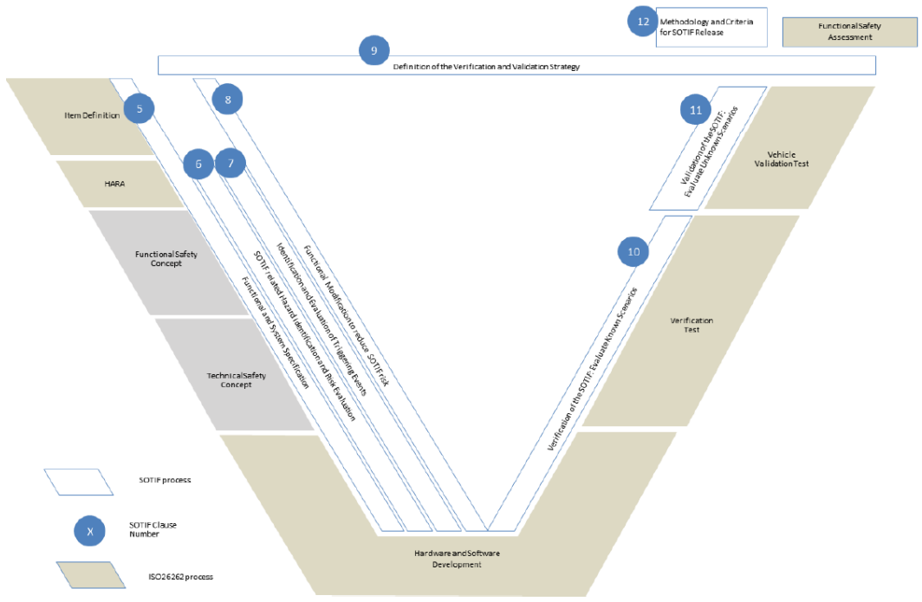
SOTIF (ISO 21448) release process
Source:
ISO 21448, Figure A.15 — Possible interactions of product development activities between this document
and the ISO 26262 series

Slide 40
What we offer
Autonomy services
Autonomy safety assessments
The examination of the results of the SOTIF activities can be considered within the functional safety assessment
Conclusion of ADAS development requires the SOTIF release and functional safety assessment
We provide the option of a SOTIF review in conjunction with the ISO 26262 assessment
We work with our customers to find the best approach for independent functional safety and autonomy evaluations
UL 4600 assessment
Assessment of the safety case for conformance examples:
  Conformance plan
  Objective vs. subjective assessment
  Assessment package
  Self-audit
Independent assessment by qualified personnel is required
Conformance monitoring must be included in the safety case
What does this all mean? Much like ISO 21448, we work with our customers to identify gaps between their current processes and techniques in comparison to UL 4600.

Slide 41
The future of autonomous systems safety
Safer vehicles require a complete safety case
  Based on functional safety
  Based on SOTIF
  Based on cybersecurity
  Based on other techniques and frameworks, e.g., UL 4600
For complex products, safety itself is complex.
Integrators must confirm suppliers’ safety arguments.
A trusted third party is a crucial element for safety.
Not one framework,
but several

Slide 42

Value proposition
depend on connectivity and data sharing to deliver Industry 4.0 benefits such as increased operating productivity and enhanced safety, as well as reduced downtime and costs.
Autonomy
It is a complex world with many complex possibilities. We work with our customers to identify the best approach to help confirm a safer product and provide third-party reviews.
There isn’t always a single best approach; therefore, we work together with our customers to find the best one for them.

Slide 43
Service portfolio: Complementary capabilities

Slide 44
Complementary capabilities
Notified body and technical service
Supplier qualifications
Organizational capability audits
Personnel certification and training
UL Solutions can support various international compliance directives and regulations including but not limited to:
Machinery Directive
ATEX Directive
RED Directive
UNECE R155 and R156
UL Solutions works across the entire supply chain, from assets (power plants, vehicles, system of systems) to semiconductors (processing units).
Empowering customers through product development and management around functional safety and cybersecurity standards
UL Solutions provides various training programs for cybersecurity, functional safety and autonomy safety standards. Professional and expert levels are available.
Training, advisory and testing — safety and security by design, gap analysis, preliminary reviews, penetration testing

Slide 45



Q&A
Contact information
Cybersecurity services
UL.com/cybersecurity
Functional safety services
  UL.com/functionalsafety
  global.functionalsafety@UL.com
<salesperson’s name>
<email address>@UL.com

Slide 46
IMS22CS508972
Notes:
Approved under WF #1146553

