Slide 1


SPIRE™ Smart Buildings
BE22CS188050
Assessment Qualification Program
2023

Slide 2



Smart buildings on the rise
BE22CS188050
Our view of smart buildings
Drivers for demand
Financial benefits
Connected ecosystems can increase occupant satisfaction, long-term
asset value and sustainability claims by managing, mitigating and monitoring risk
Power/Energy, Health and
Well-Being, Safety, Connectivity, Cybersecurity, Sustainability
Climate change - Buildings are responsible for 39% of CO2 emissions and consume 36% of the world’s energy¹
Tenant requirements – Connectivity needs are significant and growing
11.8% higher lease value and 5%
to 35% higher sales value²
37% higher rent³
Total market of $109 billion (USD) globally by 2026⁴
¹ Global Status Report 2017, Word Green Building Council, worldgbc.org.
² Macroeconomic and Other Benefits of Energy Efficiency, 2016, European Commission, https://ec.europa.eu/energy/sites/ener/files/documents/final_report_v4_final.pdf
³ The Incremental Value of Smart Buildings Upon Effective Rents and Transaction Prices, MIT Center for Real Estate, 2018, https://naiopma.files.wordpress.com/2018/09/alfredo-keitaro-bando-hano.pdf
⁴ Smart Building Market Size, Share, Growth Trends (20021-2028), Fortune, fortunebusinessinsights.com.

Slide 3

Introducing SPIRE™
BE22CS188050
The world’s first comprehensive smart building assessment and rating program
Analyzes performance holistically across
a curated framework
Results in actionable benchmarks and
a marketable star rating

Slide 4







Holistic performance assessment
BE22CS188050
Developed in coordination with TIA and diverse, industry‐leading organizations, SPIRE™’s framework addresses a building’s overall performance:
Power
and energy
Connectivity
Health and
well-being
Cybersecurity
Life and property safety
Sustainability

Slide 5

Key benefits for building owners and managers
BE22CS188050
Facilitate decarbonization of energy and mobility
Align business and building goals
Improve occupant experience and productivity
Analyze aging building stock
Enhance cybersecurity
Support Artificial Intelligence (AI) such as machine learning (ML), natural language processing (NLP),
image perception and robotics
Promote transition to 5G
Advance adoption of autonomous systems

Slide 6

SPIRE™ is appropriate for a range of customers in the building industry:
BE22CS188050
Architects
Asset owners
Building operators and managers
Equipment and systems manufacturers
Government agencies
Insurance companies
Portfolio owners/REITs
Property/portfolio solutions consultants
Utility companies

Slide 7



Three paths for SPIRE™ assessment
BE22CS188050
SPIRE™ Self-Assessment online tool
SPIRE™ Smart Buildings
Verified Assessment
SPIRE™ Qualification
Program
Building owners and managers perform their own assessments
for an initial snapshot of building performance. An instant approach
of baseline performance.
UL Solutions staff perform an
in-person or virtual audit, provide
a roadmap of performance improvements and assign a
UL Verified Mark and star rating. The only path that results in an official, marketable rating.
A new program for UL Solutions-trained third-party building professionals to broaden their
skill set and business by conducting SPIRE™ assessments. Helps advance the smart-building industry while advancing SPIRE™ priorities.

Slide 8
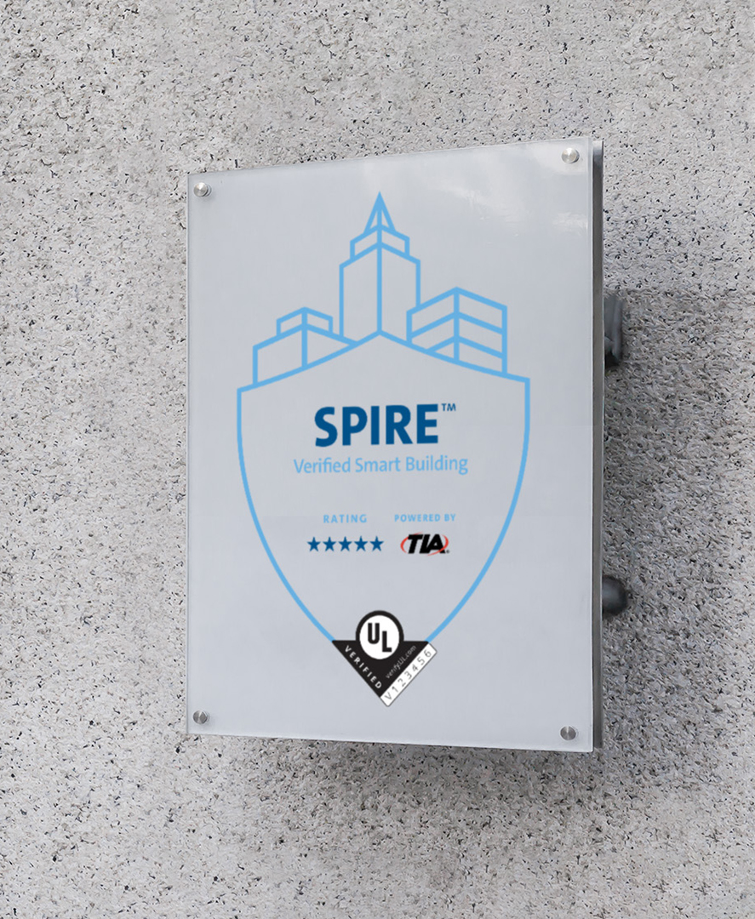
Introducing the SPIRE™
Qualification Program
BE22CS188050
Demand for smart building assessment and verification is extremely high, while the availability
of vetted assessors is low.
Here’s how UL Solutions’ new SPIRE™ Qualification Program can help:
Support the growth and evolution of the
smart-buildings industry
Expands timely access to smart building assessment and verification services
Trains and credentials seasoned building-industry professions in the SPIRE™ protocol
Empowers SPIRE™ Qualified Assessors to perform SPIRE™ Smart Building Assessments

Slide 9

Why participate in the SPIRE™
Qualification Program
BE22CS188050
By participating in the SPIRE™ Qualification Program, building professionals can:
Deepen knowledge with training direct from
UL Solutions professions.
Receive “qualified assessor” status
from UL Solutions
Cross-sell products and services to
assessment clients
Develop deeper smart-building
industry connections
Add to your existing assessment capabilities
Play an active role in building transformations

Slide 10

Ideal SPIRE™ Qualified
Assessor candidates
BE22CS188050
Experienced professionals in the building industry
are encouraged to seek qualification, including:
Architectural and engineering firms
Construction companies
Design and consulting firms
OEMs with consulting services
System integrators and solutions providers

Slide 11

SPIRE™ Qualified
Assessor candidates
BE22CS188050
Candidates should possess:
Knowledge of the smart building industry
3+ years of experience in the smart building industry. Relevant experience consulting, design, implementation of smart building projects, etc.
Assessment experience of nationally and internationally recognized standards and requirements, such as:
  ASQ-CQA certification
  ISO 9001:2015 lead assessors preferred
Knowledge of certification programs such as LEED, Fitwel and WELL

Slide 12

SPIRE™ Qualified
Assessor requirements
BE22CS188050
This comprehensive program is designed to ensure and test mastery:
Instructor-led classroom training provided by UL Solutions
  Online SPIRE™ assessment tool
  Program evaluation criteria, program and process requirements
  Roles and responsibilities
  Requirements for objective evidence gathering and its materiality
Written examination
Field training
  Verified assessments conducted under supervision of UL SPIRE™ engineers
Upon completion of these steps, assessors are deemed “qualified”
and authorized to perform verified assessments without supervision.

Slide 13

Maintaining SPIRE™ qualification
BE22CS188050
SPIRE™ Qualified Assessor certificates are
valid for two years, then all assessors must successfully retake the written exam
Demonstrate adherence to program criteria
and processes
Conduct a minimum number of assessments
per year
If an assessor has not met contract requirements
or failed to demonstrate program competency,
UL Solutions may require additional classroom
or field training.
UL Solutions reserves the right to terminate an assessor’s qualification.

Slide 14

Two Levels in the SPIRE™ Qualification Program
BE22CS188050
SPIRE Qualified Assessor – Professional
Completed full SPIRE™ training and onboarding
Entry-level assessor status
SPIRE Qualified Assessor – Expert
Completed full SPIRE™ training and onboarding
Conducted a minimum 15 SPIRE™ assessments within two years
Participate in SPIRE™-related panels and webinars
Act as a TIA Smart Buildings Working Group (SBWG) member
Included in smart buildings networks and ecosystem

Slide 15

What we expect of SPIRE™
Qualified Assessors
BE22CS188050
Fulfill contractual obligations
Market SPIRE™ to your customers via UL Solutions-produced
marketing collateral
Conduct SPIRE™ Platform demonstrations and facilitate self-assessments with their customers. Perform at least one self-assessment for your building or a customer’s building
  Conduct one verified assessment for your building, where possible
  Conduct guided self-assessments for their customers and their own buildings
  Prepare customers for verified assessments
  Administer verified assessments for customer buildings
  Provide feedback on the SPIRE™ program to UL Solutions to foster
  continuous improvement
Ensure assessors maintain and enhance smart building knowledge and trends by staying involved with projects of varied complexity and scope
Attend continuing education offerings organized by UL Solutions/TIA regarding SPIRE™ and smart buildings, e.g., webinars, panel discussions

Slide 16

What SPIRE™ Qualified Assessors and Companies should expect from UL Solutions
BE22CS188050
Perform comprehensive onboarding of qualified company and assessors
Offer training on all aspects of the program to secure
and maintain qualification status
Engage assessors in continuing education regarding
smart building
Add and promote qualified company and assessors
in our website and other marketing channels
Provide marketing collateral to promote SPIRE™
to their customers
Include them in SBWGs based on their participation, knowledge, market leadership and influence
Re-evaluate assessors to ensure ongoing mastery of SPIRE™ platform
Spot-check audits conducted to ensure quality
and accuracy

Slide 17
Process Flow
BE22CS188050
Accepts
quote from
Partner
Registers
on SPIRE™
website
Completes
free SA
Accepts quote
from
UL Solutions
Accepts GSA on
SPIRE™ platform
or manually
Receives
report,
approval letter
Customer
Partner
Sells and
quotes for VA
Informs/
emails
UL Solutions
Coordinates
schedules and
performs VA
Enters data in
SPIRE™
platform
Updates SPIRE™ logo in
platform, update report, send
report to customer, facilitates
order close & artifact creation
SPIRE™ Team
Facilitates
customer & quote
creation in Oracle
Sets up
customer
on SPIRE™
Sends quote
to customer
Facilitates
order booking
Sets up
Partner to
conduct VA
Completes
Verified mark
application
Oracle Admin
Sets up
customer
on Oracle
Quotes for VA
review + SPIRE™
Verified Mark
(MCV Catalog)
Books
Order in
Oracle
Closes Oracle
order > Oracle
Invoices customer
UL Solutions Assessor/Reviewer
Reviews VA
Completes VA
Generates Report
Issues V#. issues approval letter updates
MCV website
MCV Lead
FastSigns
Works with UL Solutions
or customer to send
artifact (table tent, plaque etc.)

Slide 18

Financial benefits for SPIRE™
Qualified Assessors and Companies
BE22CS188050
SPIRE™ assessments can be a lucrative addition to a professional’s array of services. Here are standard costs for services for buildings in the United States:
Fewer than 250K square feet – $15,000
250K-500K square feet – $20,000
500K-1M square feet – $25,000
1M-2M square feet – $30,000
More than 2M and special-use venues:
See UL Solutions for quote
Discounts and region-specific pricing may apply.

Slide 19

Financial impacts for SPIRE™
Qualified Assessors and Companies
BE22CS188050
We have designed the program to be cost-effective for professionals, while maintaining high quality.
Sample of fees for U.S. assessors:
Onboarding fees – complimentary
Initial training and examination fees – $2,500
per assessor
Re-qualification training and examination fees (every two years) – $1,500 per assessor
Annual subscription fee for adding company and assessor names in our website/qualified company
database – $5,000
Discounts may apply.

Slide 20

Get Started
BE22CS188050
Please complete this online form to begin your registration process.
Fields should include:
Company name:
Company address:
Website address:
Services provided (multiple choice): System integrator, design consulting, architectural and engineering, construction, OEM
Number of employees: 0-25, 26-100, 101-250, 251+
Contact information: First name, Last name, Business phone number, Business email

Slide 21
BE22CS188050

